Slide 1
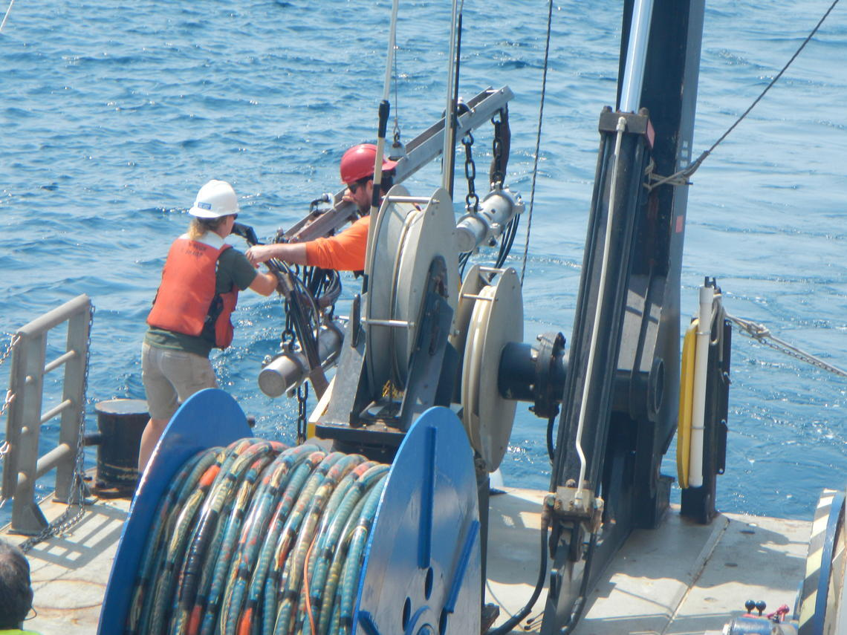
READING SEISMIC DATA
Before the data,
there is a pulse
A marine source releases compressed air. The returning energy becomes traces, a SEG-Y file, and finally a 3D image of the subsurface.
Pulse -> reflection -> receiver -> trace -> SEG-Y -> 3D volume -> source -> migration -> reservoir -> seal -> trap -> Azerbaijan
01
Notes:
Opening: Begin with the physical source, not with SEG-Y. Point to the deployed air guns and say that every trace in the project begins with a controlled pressure pulse.
Click the embedded 20-second slow-motion air-gun release video. If media playback is blocked, use the linked YouTube clip instead.
Transition: The source creates energy. The next question is how that energy travels, returns, and becomes a recorded signal.
Sources and visual credits:
- USGS air-gun deployment photo: https://www.usgs.gov/media/images/deploying-two-seismic-sources-0
- Embedded video: SLB, eSource Airgun Energy Release: https://www.slb.com/videos/esource-airgun-energy-release
- Presenter-selected alternate clip: https://youtu.be/WpblB3xToZ4

Slide 2
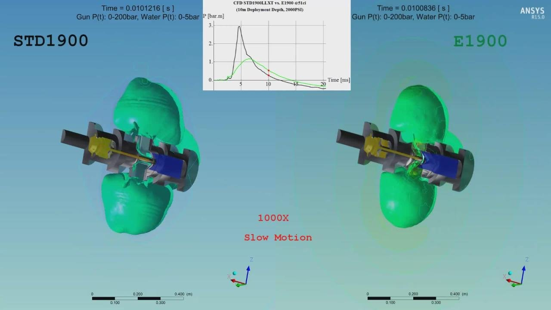
Air gun – Energy sender
animation

Slide 3
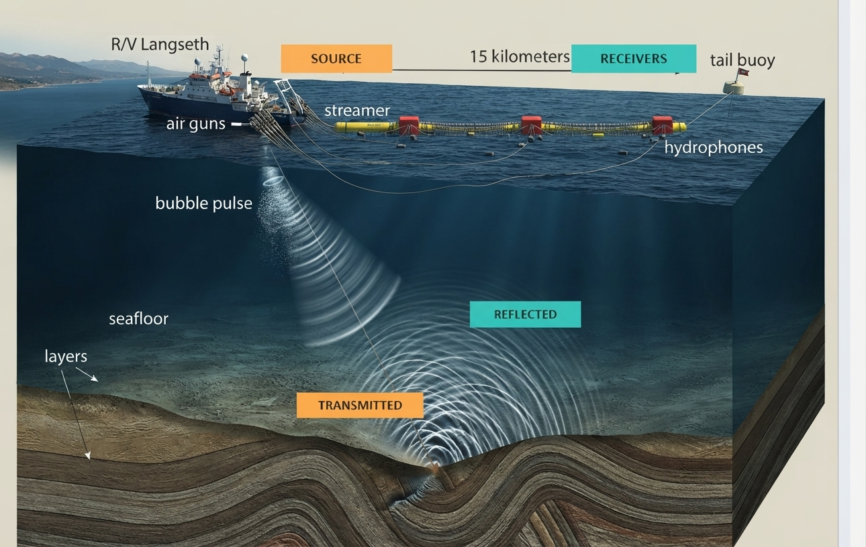
SEISMIC DATA AND PETROLEUM SYSTEMS
02
How the wavefield becomes recorded data
01
Source pulse
The air-gun array releases a short pressure pulse at a known position.
02
Reflection and transmission
At each acoustic-impedance contrast, part of the energy reflects and part continues downward.
03
Receiver sampling
Hydrophones along the streamer record pressure through time at known locations.
Travel time plus acquisition geometry lets processing place reflections in the subsurface.
Notes:
Point to the source first, then the streamer. Follow one ray downward. At each boundary, explain that the energy splits: some reflects upward and some transmits deeper.
Hydrophones do not directly record a geological layer. They record pressure changes through time. Processing uses timing and geometry to build the image.
Transition: Each receiver channel produces one amplitude-versus-time trace. Four selected channels therefore give us four traces.
Sources and visual credits:
- CASIE21 marine acquisition diagram, Pacific Northwest Seismic Network: https://pnsn.org/blog/the-cascadia-seismic-imaging-experiment-2021-casie21-all-aboard-the-r-v-marcus-g-langseth
- Reflection-seismology explanation: https://www.iris.edu/hq/inclass/animation/reflection_seismology_seeing_below_the_ground

Slide 4
Animation

Slide 5
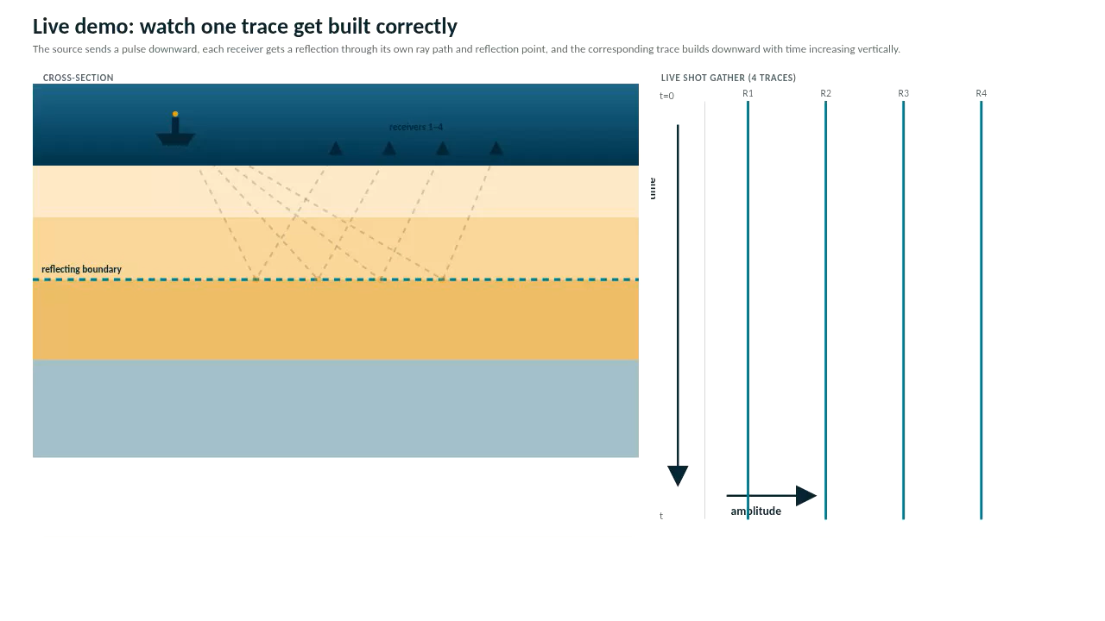
Animation

Slide 6
SEG-Y connects samples with location
File header
survey context, sample format and timing
Trace 1 header
Trace 2 header
Trace 3 header
Trace 4 header
Header = metadata
Samples = signal
Inline + crossline = grid address
5
Notes:
A trace contains signal values, but its header tells us how to interpret and locate them. SEG-Y stores file-level information and repeated trace records. A trace header can carry inline and crossline numbers and sampling information; the sample array carries the waveform. In computer-science language, the header is metadata and the samples are data. Reference: SEG-Y rev 2.0, https://seg.org/wp-content/uploads/2025/11/seg_y_rev2_0_mar2017.pdf

Slide 7
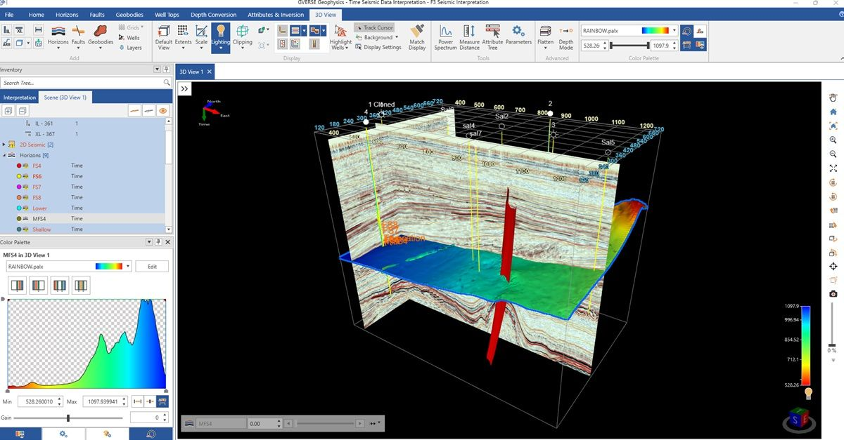
SEISMIC DATA AND PETROLEUM SYSTEMS
05
Inside a 3D seismic volume
INLINE
A vertical section along one axis of the acquisition grid.
CROSSLINE
A vertical section perpendicular to the inline direction.
TIME / DEPTH SLICE
A horizontal cut at one two-way time or depth level.
VOXEL
One sample at a specific inline, crossline, and time/depth index.
Thousands of positioned traces become one navigable volume.
▶ Open a browser-based 3D cube demo
Notes:
Rotate the audience's mental model from separate traces to a cube. Identify the two vertical section directions and the horizontal time or depth slice.
A voxel is one sample within the 3D grid. It has a location and an amplitude value; derived attribute cubes may add further values at the same location.
Transition: The next slide shows the operational viewer and separates what organizes the cube from what the model actually learns from.
Sources and visual credits:
- 3D seismic volume figure, University of Houston Pressbooks, adapted from IRIS/FW Schroeder: https://uhlibraries.pressbooks.pub/historicalgeologylab/chapter/geologic-structures-and-mapping/
- SEG Wiki, time slice: https://wiki.seg.org/wiki/Time_slice

Slide 8
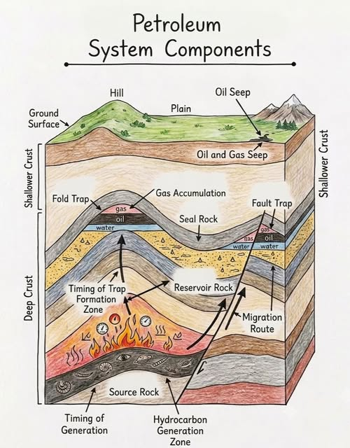
SEISMIC DATA AND PETROLEUM SYSTEMS
07
Five checks in the petroleum-system story
01
Source rock
Generates petroleum after sufficient burial and heating.
02
Migration
Charges a reservoir through carrier beds, fractures, or faults.
03
Reservoir rock
Provides pore space and connected flow paths.
04
Seal rock
Restricts further movement across the top or sides.
05
Trap
Creates closure or termination where petroleum can accumulate.
Notes:
Introduce all five items quickly. The purpose is to establish the route before the separate slides: generation, charge, storage, containment, and closure.
For technical accuracy, mention that formal petroleum-system terminology distinguishes rock elements from processes. The five-part sequence here is a presentation structure.
Transition: Begin with the source rock and tell the generation story without reducing it to 'dead fish'.
Sources and visual credits:
- Petroleum-system overview image: https://www.stag-geological.com/petroleum-systems
- AAPG petroleum-system definition: https://wiki.aapg.org/Petroleum_systems
- USGS petroleum-system definition: https://pubs.usgs.gov/dds/dds-060/chaps/PS.pdf

Slide 9
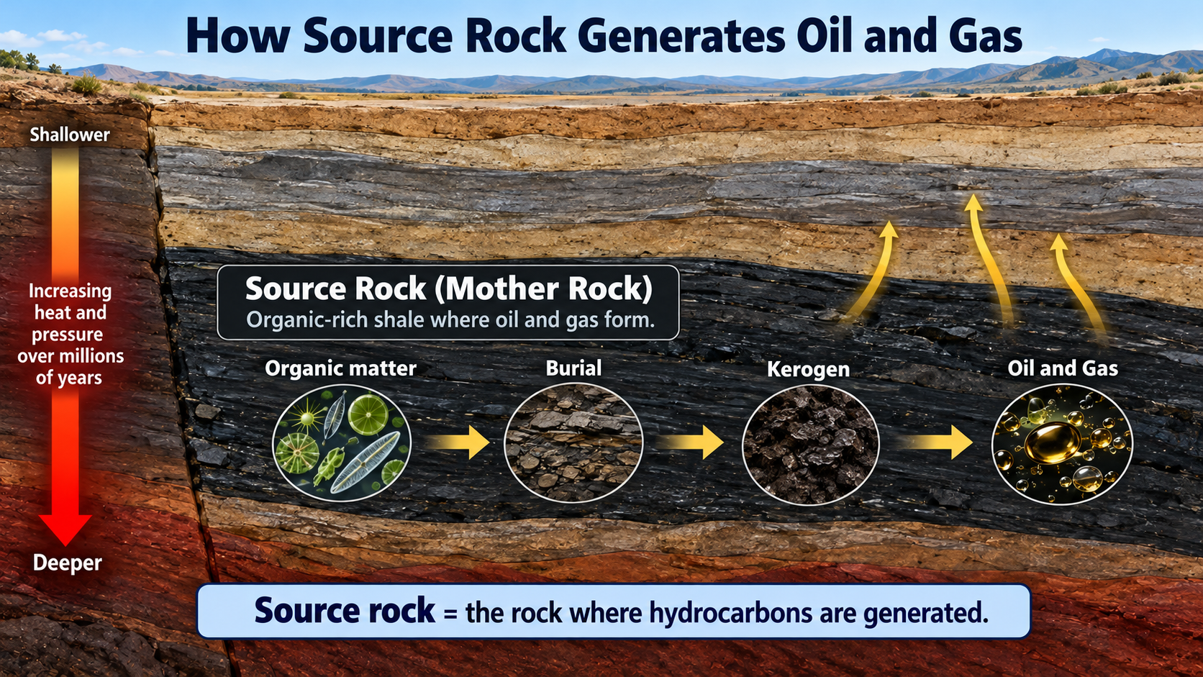
SEISMIC DATA AND PETROLEUM SYSTEMS
Source rock: organic matter becomes petroleum
01
Deposition
Algae, plankton, microbes, and some land-derived organic matter settle with fine sediment.
02
Preservation
Low-oxygen conditions reduce decay and preserve organic material in mud-rich sediment.
03
Burial and heating
Organic matter becomes kerogen, then generates oil and gas as temperature and time increase.
04
Expulsion
Generated fluids leave the tight source interval when pressure and capillary conditions permit.
Generation windows depend on kerogen type and heating history.
Notes:
Tell the source-rock story as a sequence. Organic matter commonly includes algae, plankton, microbes, and terrestrial material; 'dead fish' is too narrow.
Burial and heat convert preserved organic matter into kerogen and then petroleum over geologic time. Exact generation windows vary with kerogen type and thermal history.
Transition: Generation alone does not place petroleum in a productive reservoir. The fluids must leave the tight source interval and migrate.
Sources and visual credits:
- Shale core image: https://www.mdpi.com/2076-3263/10/10/381
- Azerbaijan source-rock study: https://onlinelibrary.wiley.com/doi/10.1111/jpg.12797

Slide 10
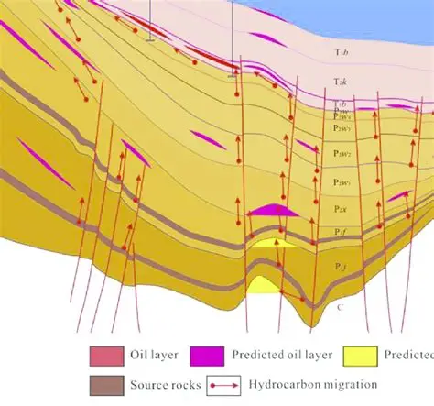
SEISMIC DATA AND PETROLEUM SYSTEMS
09
Migration: charge through carrier beds and faults
PRIMARY MIGRATION
Expulsion from the source rock into a more permeable carrier.
FAULT BEHAVIOR
A fault may transmit, redirect, or seal. Juxtaposition, clay smear, and stress determine its role.
Conventional reservoirs often flow more readily than tight source rock because their pore network is more connected.
Notes:
Correct a key point: migration is the movement of hydrocarbons; it is not another word for fault. Faults are only one possible pathway and can also seal.
Primary migration moves fluids out of the low-permeability source. Secondary migration moves them through carrier beds, fractures, or faults toward a trap.
The arrows on the seismic section are conceptual, not an interpretation of proven fluid pathways in the displayed line.
Transition: Because faults are breaks and folds are bends, distinguish them before discussing how either can create or modify a trap.
Sources and visual credits:
- Hovsan field seismic-stratigraphy image: https://www.aimspress.com/article/doi/10.3934/geosci.2021005
- AAPG petroleum-system overview: https://wiki.aapg.org/Petroleum_systems

Slide 11
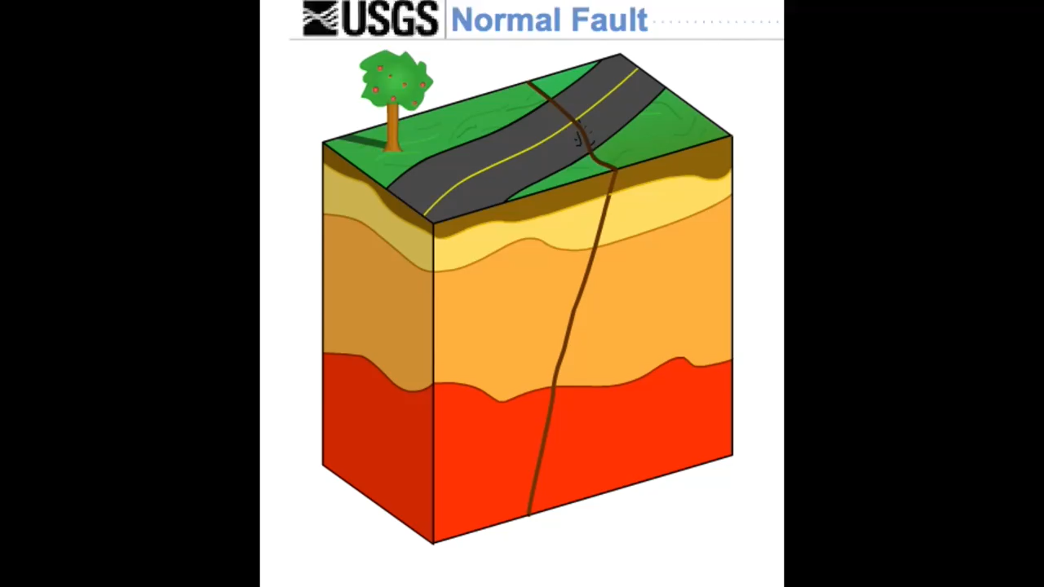
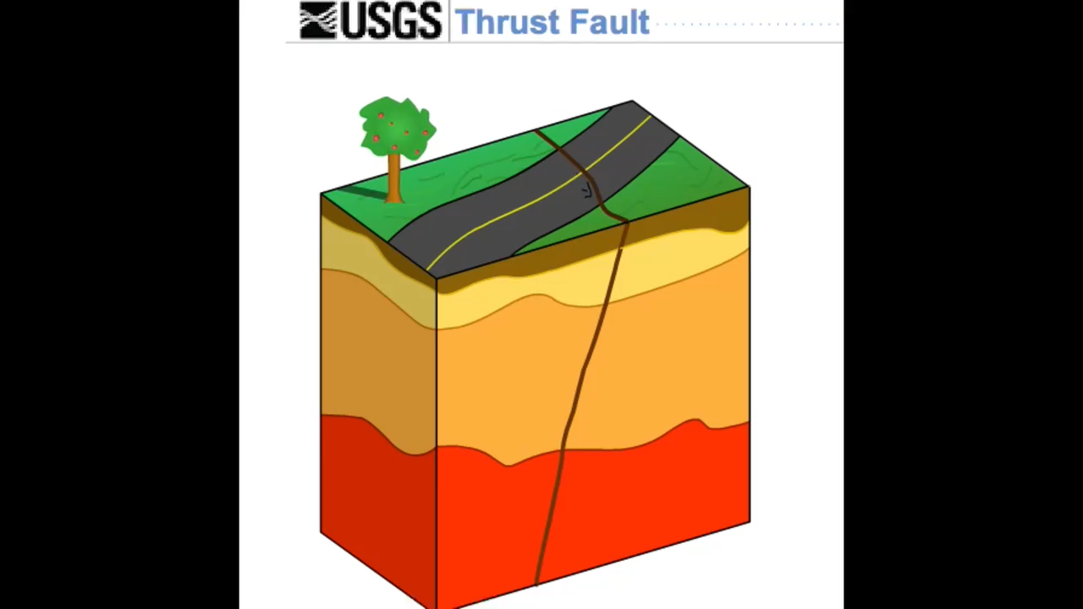
Normal fault vs Reverse/Thrust fault

Slide 12
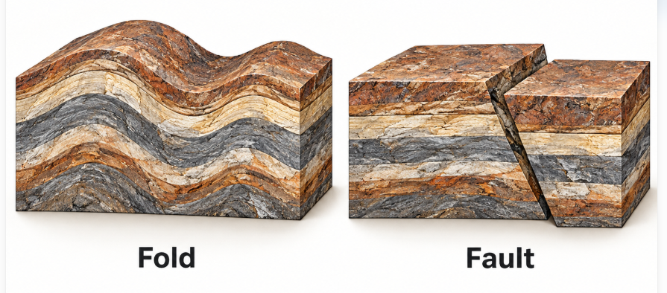
SEISMIC DATA AND PETROLEUM SYSTEMS
10
Fold versus fault
FOLD
Layers bend. Continuity may remain even when the geometry changes strongly.
Notes:
Use the real fold photograph to show bending of continuous beds. Then use the fault block diagrams to show a fracture with displacement.
Normal faults form under extension with the hanging wall moving down. Reverse and thrust faults form under compression with the hanging wall moving up.
The links open official USGS motion examples if you want to animate either fault type.
Transition: Migration needs a destination. The reservoir must both store fluid and allow it to move.
Sources and visual credits:
- Fold photograph, Wikimedia Commons: https://commons.wikimedia.org/wiki/File:Sevehah_Cliff.jpg
- Fault diagrams, U.S. National Park Service: https://www.nps.gov/subjects/geology/geologic-illustrations.htm
- USGS fault animations: https://www.usgs.gov/programs/earthquake-hazards/earthquake-animations

Slide 13
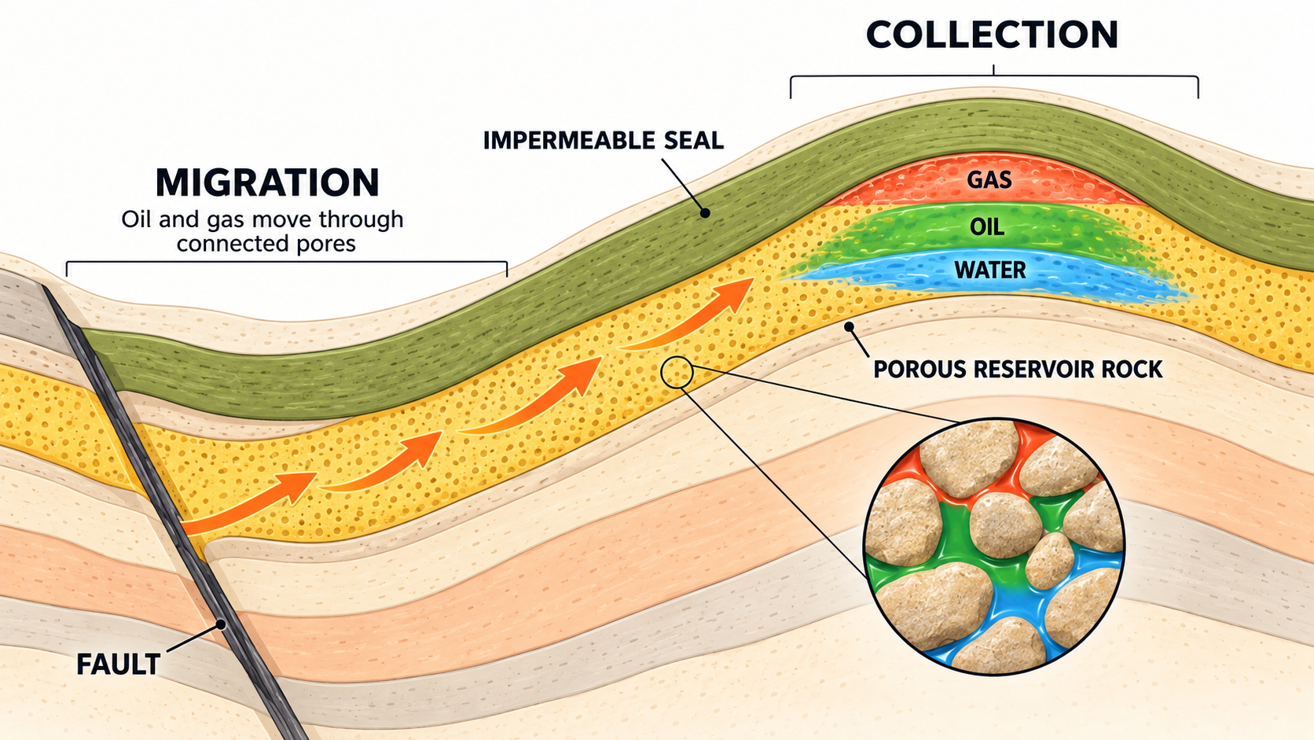
SEISMIC DATA AND PETROLEUM SYSTEMS
11
Reservoir rock: storage and deliverability
POROSITY
The fraction of the rock volume occupied by pores.
PERMEABILITY
The ability of connected pores and fractures to transmit fluid.
COMMON RESERVOIRS
Sandstone and carbonate rock. Grain size, sorting, cementation, dissolution, and fractures control reservoir quality.
Formation Of Reservoir Rock | Oil & Gas Animations
The fluids occupy a connected pore network inside the rock.
Notes:
Define porosity as storage and permeability as connectivity. A rock can have pores yet transmit fluid poorly if the pore throats are not connected.
The micro-CT image visualizes fluid distribution inside a sandstone core plug. Use it to move the audience from a cartoon reservoir to real pore-scale data.
Transition: The same connectivity that supports production can also allow hydrocarbons to escape. A low-permeability seal must contain the accumulation.
Sources and visual credits:
- TESCAN multiscale micro-CT reservoir image: https://tescan.com/applications/geo-sciences/oil-and-gas-research

Slide 14
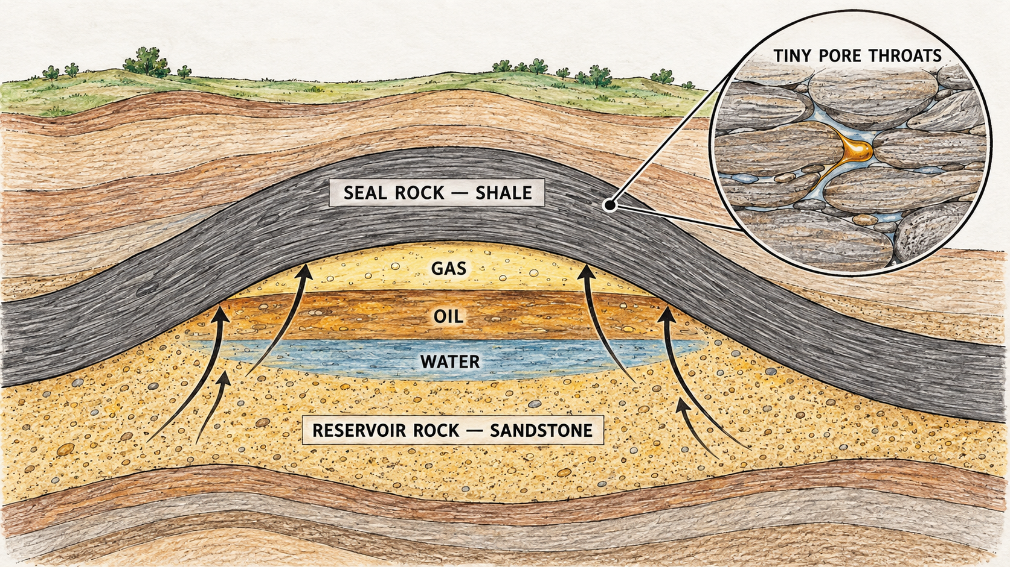
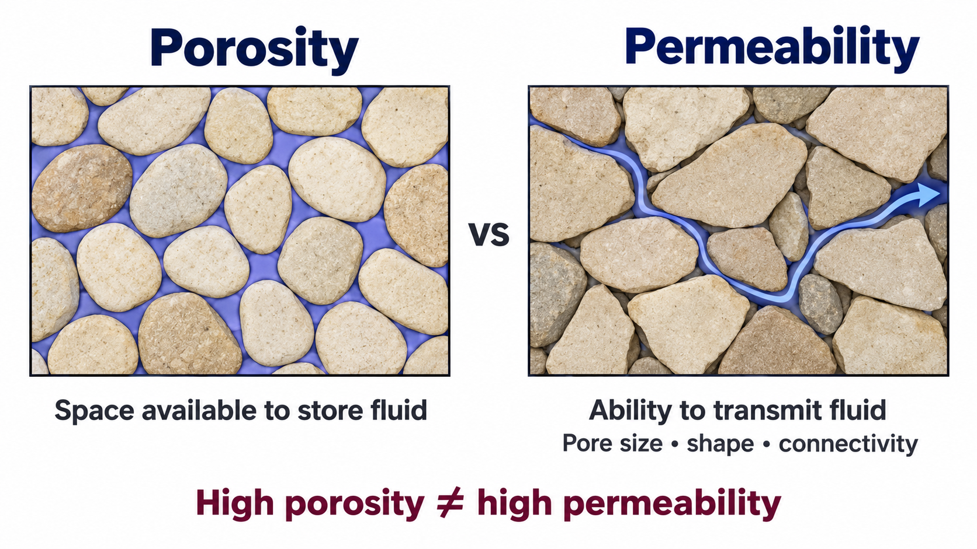
SEISMIC DATA AND PETROLEUM SYSTEMS
12
Seal rock: the barrier above the reservoir
LOW PERMEABILITY
CONTINUITY AND INTEGRITY
COMMON SEAL LITHOLOGIES
Small pore throats slow cross-seal flow and create high capillary entry pressure.
Thickness, lateral continuity, faults, and fractures determine whether containment persists.
Shale and mudstone are common. Evaporites such as salt and anhydrite can form exceptionally effective seals.
Notes:
Explain that companies do not place a seal over a reservoir. The seal is a natural rock unit whose pore-throat structure restricts hydrocarbon movement.
Good sealing depends on capillary entry pressure, continuity, thickness, and structural integrity. Faults can enhance or breach containment depending on their properties.
Transition: Containment alone is insufficient. The geometry must also create closure, which brings us to the trap.
Sources and visual credits:
- Norwegian Offshore Directorate core photograph: https://factpages.sodir.no/en/wellbore/PageView/Development/All/3170
- AAPG trap and seal overview: https://wiki.aapg.org/Trap

Slide 15
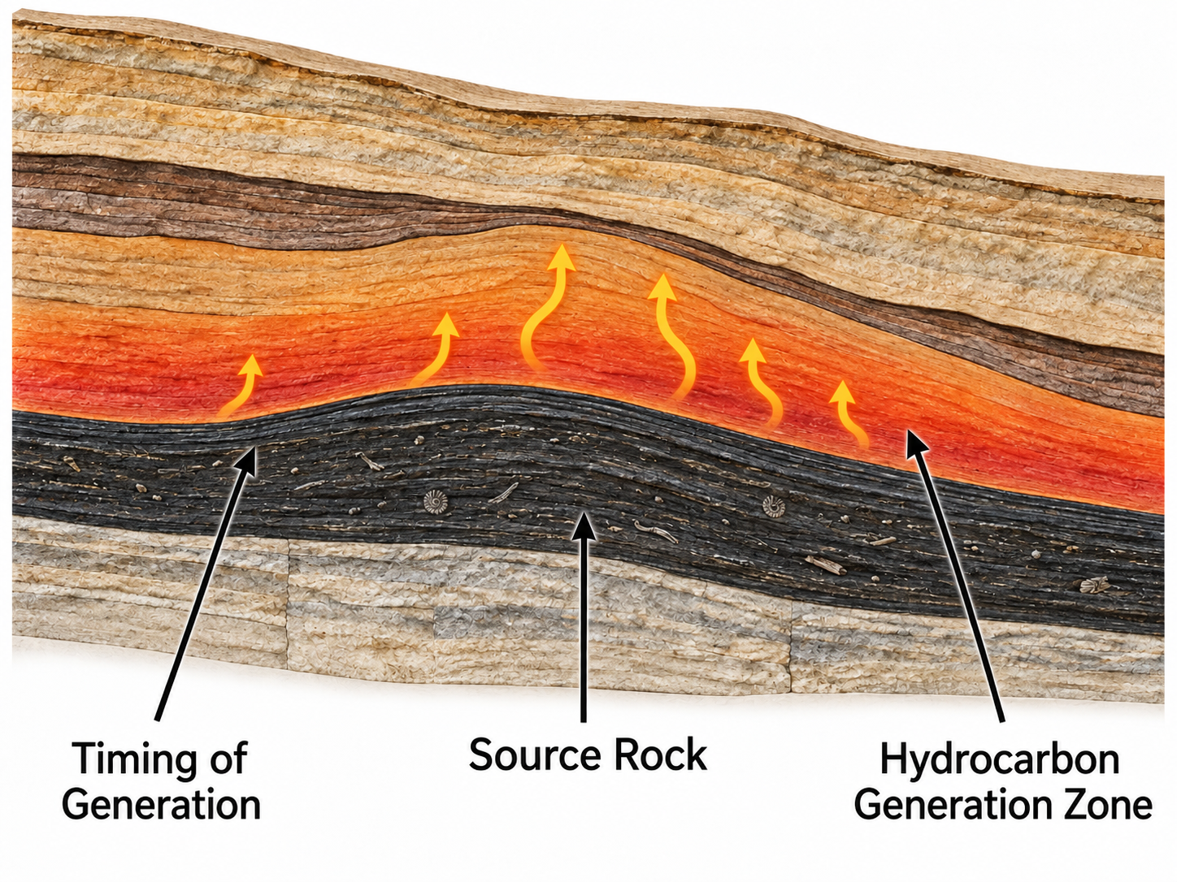
SEISMIC DATA AND PETROLEUM SYSTEMS
13
Trap: closure plus seal
STRUCTURAL
Anticline, fault, or salt-related closure.
COMBINATION
Structural and stratigraphic controls acting together.
Notes:
Define the trap as the geometry and boundaries that stop continued migration and create a closed accumulation. Seal is part of containment; closure determines the finite volume.
The highlighted arch is a structural closure in a real seismic section. Do not claim hydrocarbons from shape alone. Charge, reservoir quality, and seal integrity still require evidence.
Transition: The final slide places the same logic in Azerbaijan, where regional shortening created many young folds in the South Caspian region.
Sources and visual credits:
- Kupal anticline seismic and interpreted section: https://www.academia.edu/70377532/The_Middle_Cretaceous_Lower_Miocene_3D_petroleum_system_Modeling_of_Kupal_Oil_Field_South_West_of_Iran_Dezful_Embayment
- AAPG trap definition: https://wiki.aapg.org/Trap

Slide 16
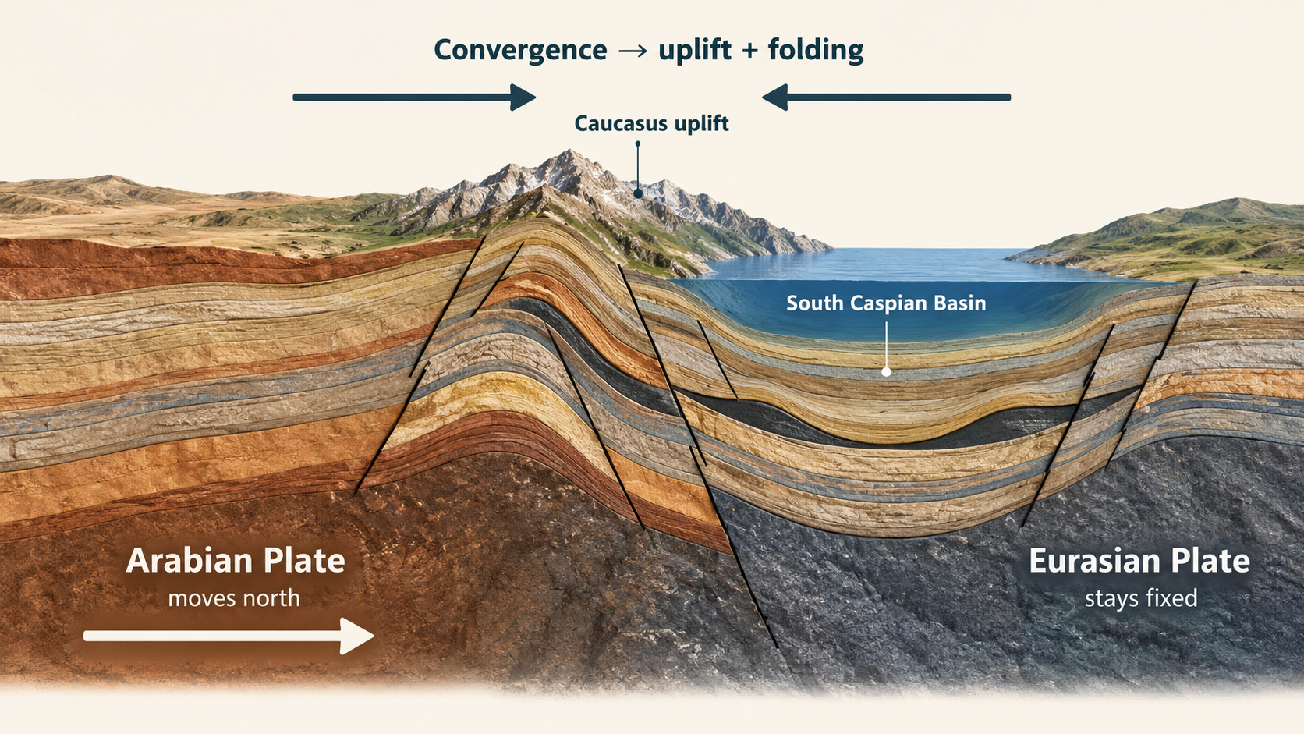
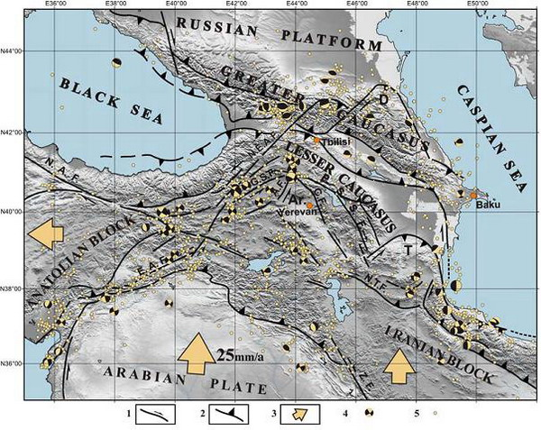
SEISMIC DATA AND PETROLEUM SYSTEMS
14
Why Azerbaijan contains young fold traps
AZERBAIJAN
REGIONAL SHORTENING
Arabia-Eurasia convergence shortens the Caucasus and folds young South Caspian sediments.
PETROLEUM SYSTEM
Maikop and Diatom intervals are major sources. Productive Series sandstones are principal reservoirs, with mudstone-rich intervals providing seals.
Notes:
Use the top-view map to show the northward Arabian plate motion and the Caucasus deformation zone. Point out Azerbaijan and the western South Caspian margin.
Regional convergence and late Cenozoic deformation folded the thick South Caspian sedimentary succession. These folds created many young structural closures.
Connect the local petroleum system: Maikop and Diatom intervals are major source rocks; Productive Series sandstones form principal reservoirs; mudstone-rich intervals act as seals. Each prospect still needs seismic, well, and geochemical evidence.
Closing line: Regional tectonics creates the structure; field data decide whether it works.
Sources and visual credits:
- Caucasus active-tectonics map: https://geology.am/en/lab-geodynamics-maps/
- South Caspian seismic autotrace: https://homepage.ufp.pt/biblioteca/AtlasOfTypicalDeepWaterSeismicLines/OffsBasins/3Exemples/Europe/Page22.htm
- Active tectonics of the South Caspian Basin: https://academic.oup.com/gji/article/148/2/214/597277
- Azerbaijan source rocks: https://onlinelibrary.wiley.com/doi/10.1111/jpg.12797
- South Caspian Productive Series reservoirs and seals: https://www.sciencedirect.com/science/article/pii/S0264817204000285

